Slide 1
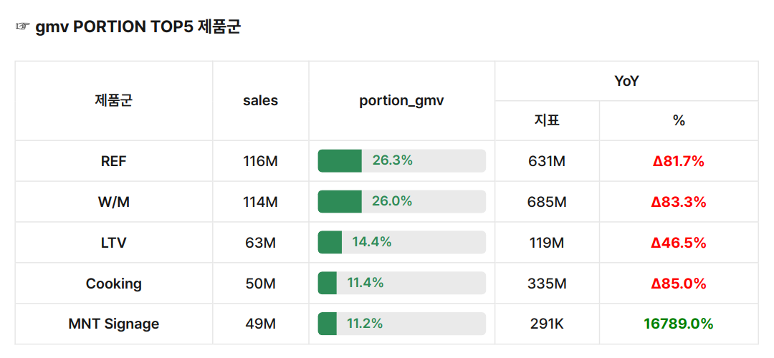
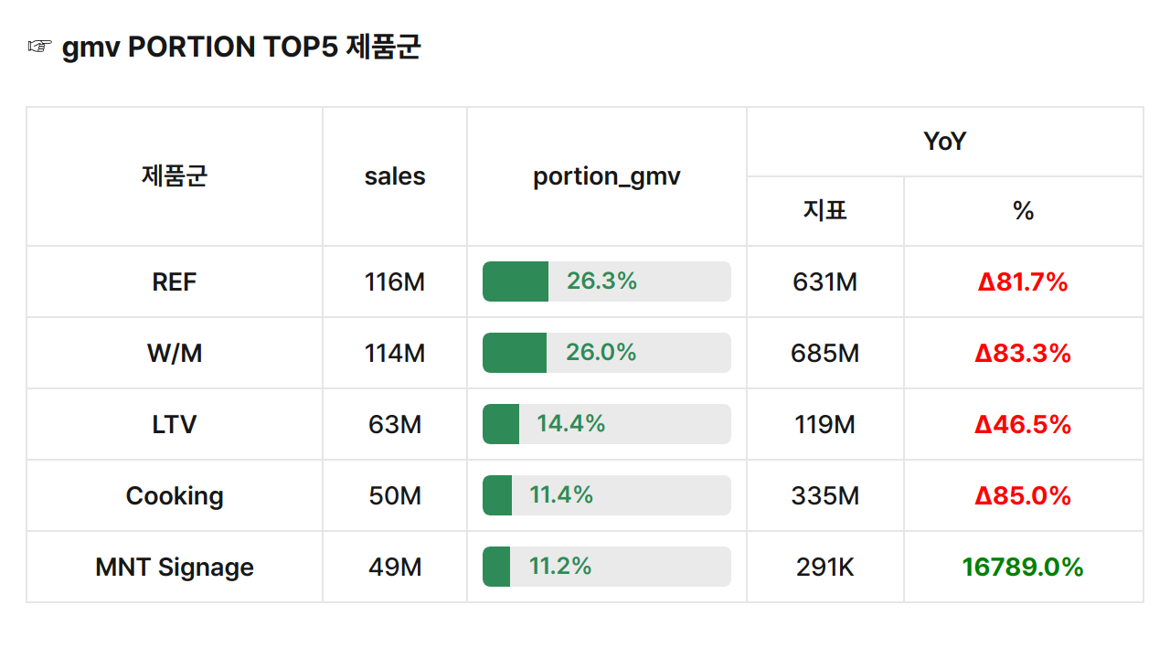
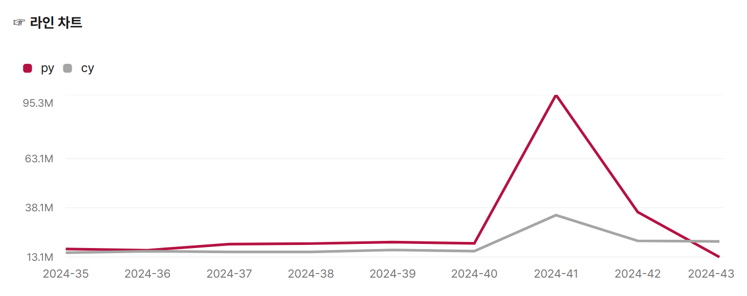

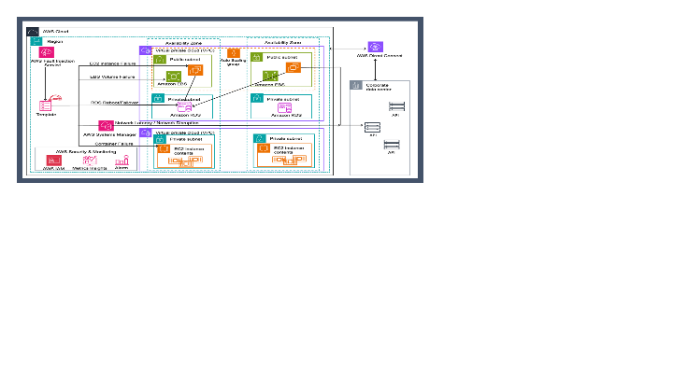
☞ 2024 매출 현황
유형 | 2024 |  | YoY
 |  |  | 지표 | %
gmv | sales | 439M | 2,062M | Δ78.7%
 | order | 45K | 26K | 76.5%
 | qty | 45,987K | 53,337K | Δ13.8%
 | aov | 9,746 | 80,687 | Δ87.9%
 | asp | 10 | 39 | Δ75.3%
testestsetsetse

Slide 2
